Slide 1

Eventix
Event Ticketing & Management Platform
Presented by:
Swetankan Kumar Sinha
2312res902
B.Sc. Computer Science & Data Analytics
Indian Institute of Technology Patna

Slide 2

Problem Statement & Objectives
Problem Statement:
Objectives:
• Difficulty in managing events, ticket booking, and user-organizer interaction in a centralised platform.
Enable users to browse, search, and book event tickets easily.
Provide event organisers tools to manage events and track sales.
Give admins full control over users, categories, and flagged events.

Slide 3

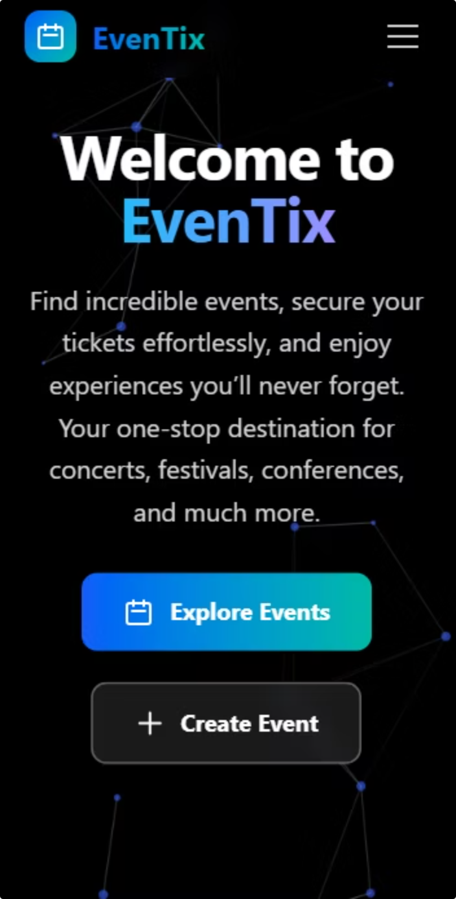
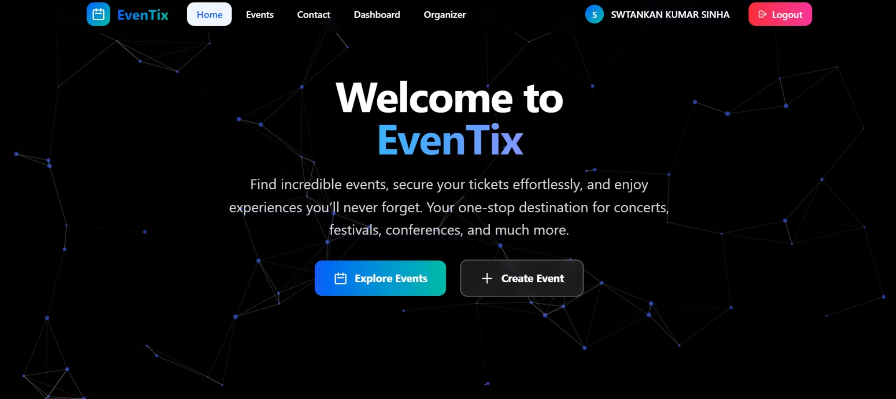
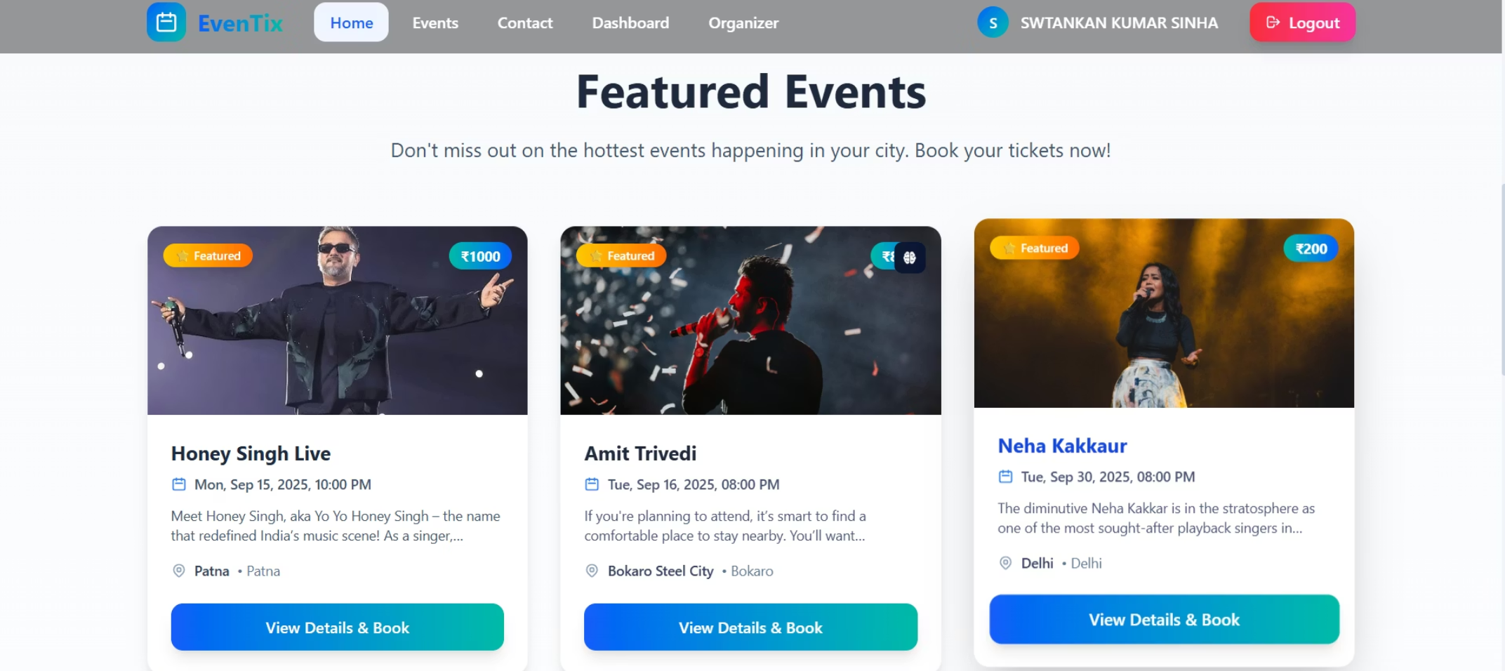
User-Friendly Interface & Responsive Design
• Developed using React and TailwindCSS for a modern and responsive UI.
• Simple navigation flow ensures an intuitive user experience on both desktop and mobile.

Slide 4
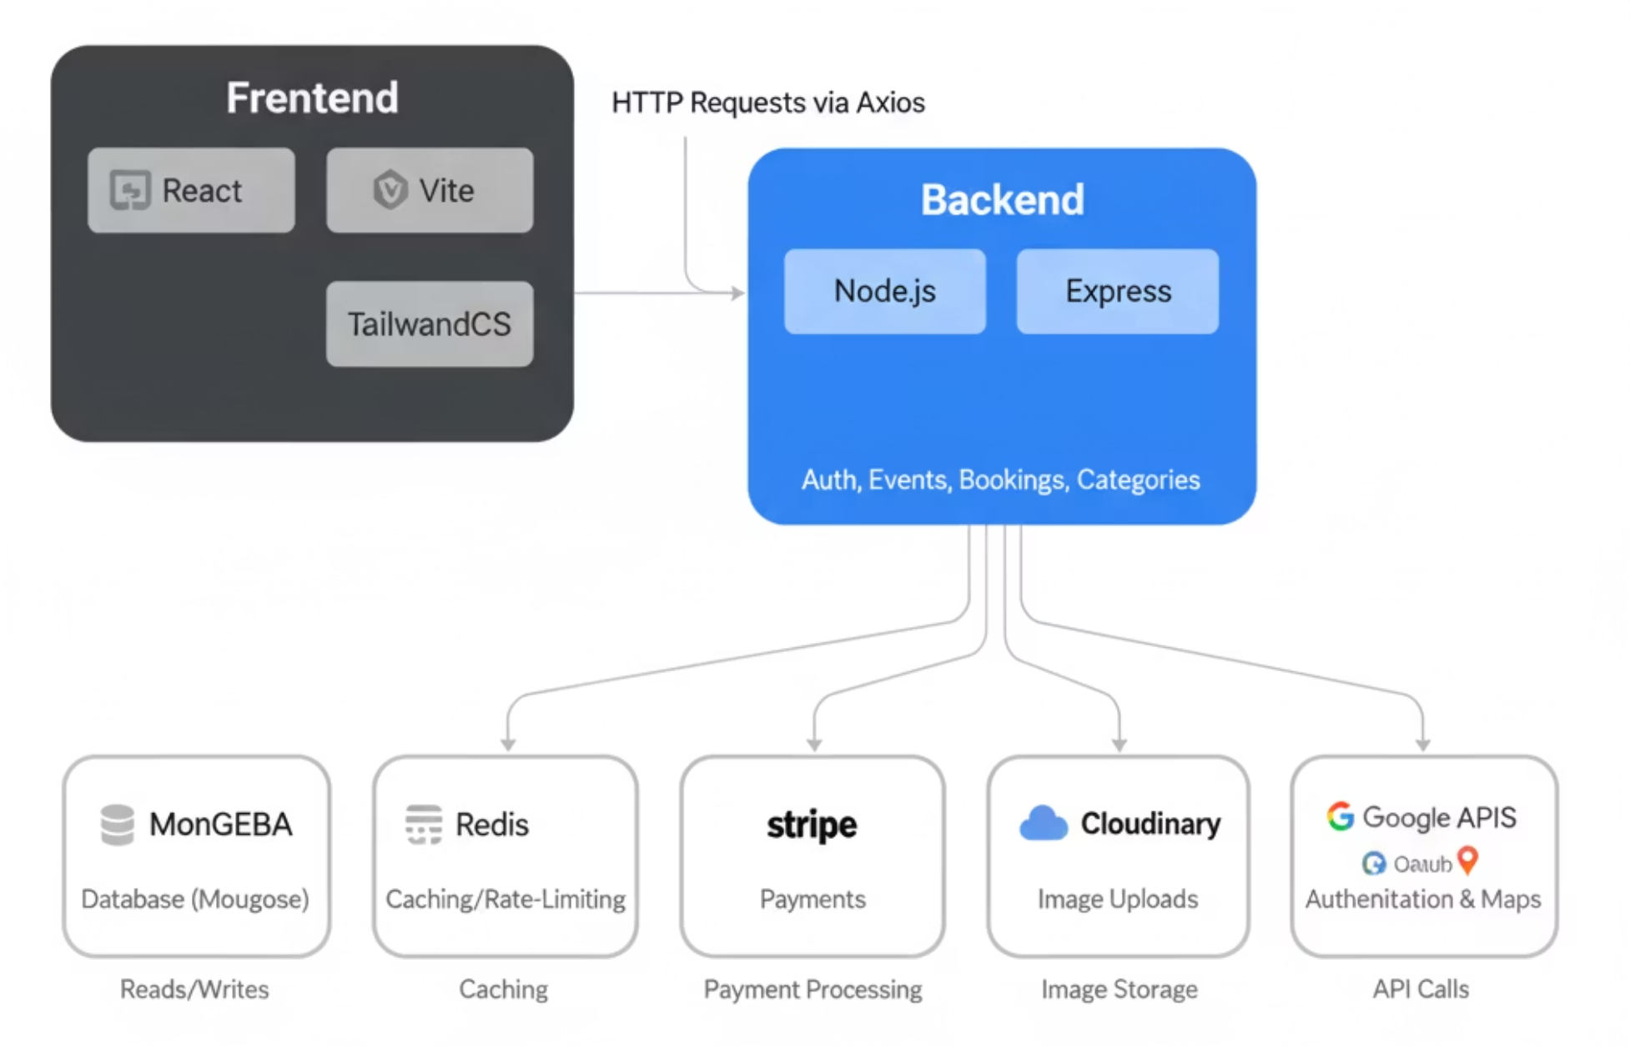

Backend Architecture
Backend Components:
Express.js RESTful API Server
MongoDB for data persistence
Redis for caching and rate limiting
Stripe for payment processing
Google OAuth for authentication

Slide 5
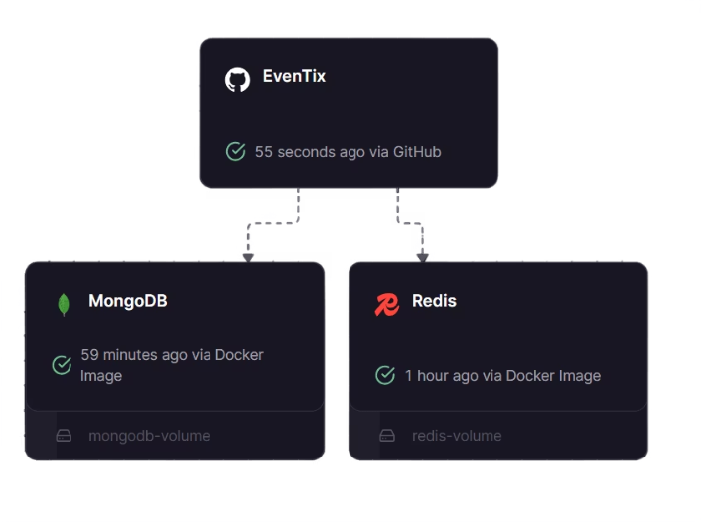
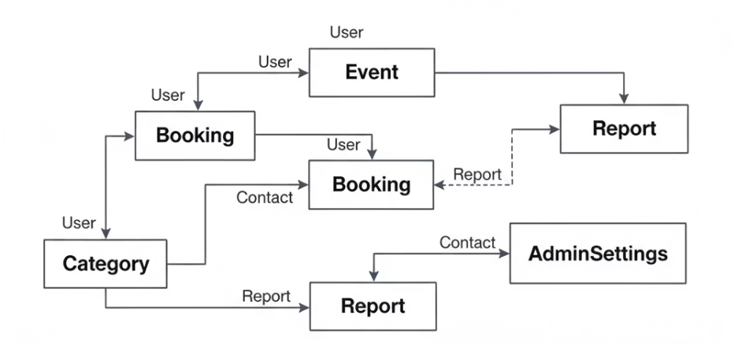
Database Schema Design & Security
Key Database Models:
User
Booking
Stores user details with secure password hashing (bcrypt)
Stores ticket booking records linked to users and events
1
2
3
4
Event
Category
Stores event details (images, venue, date, capacity)
Categories events for easier filtering
Railway Backend Deployment
Security Measures:
Diagram of database schema showing tables and relationships
JWT for authentication with expiry
Input validation middleware
Password hashing with bcrypt

Slide 6
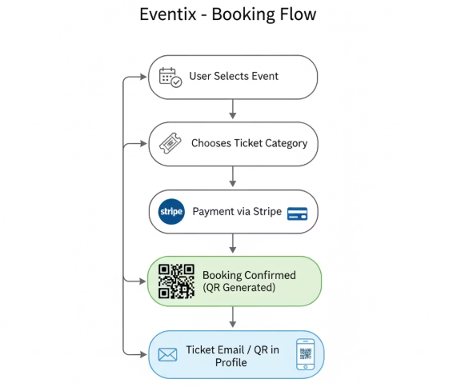
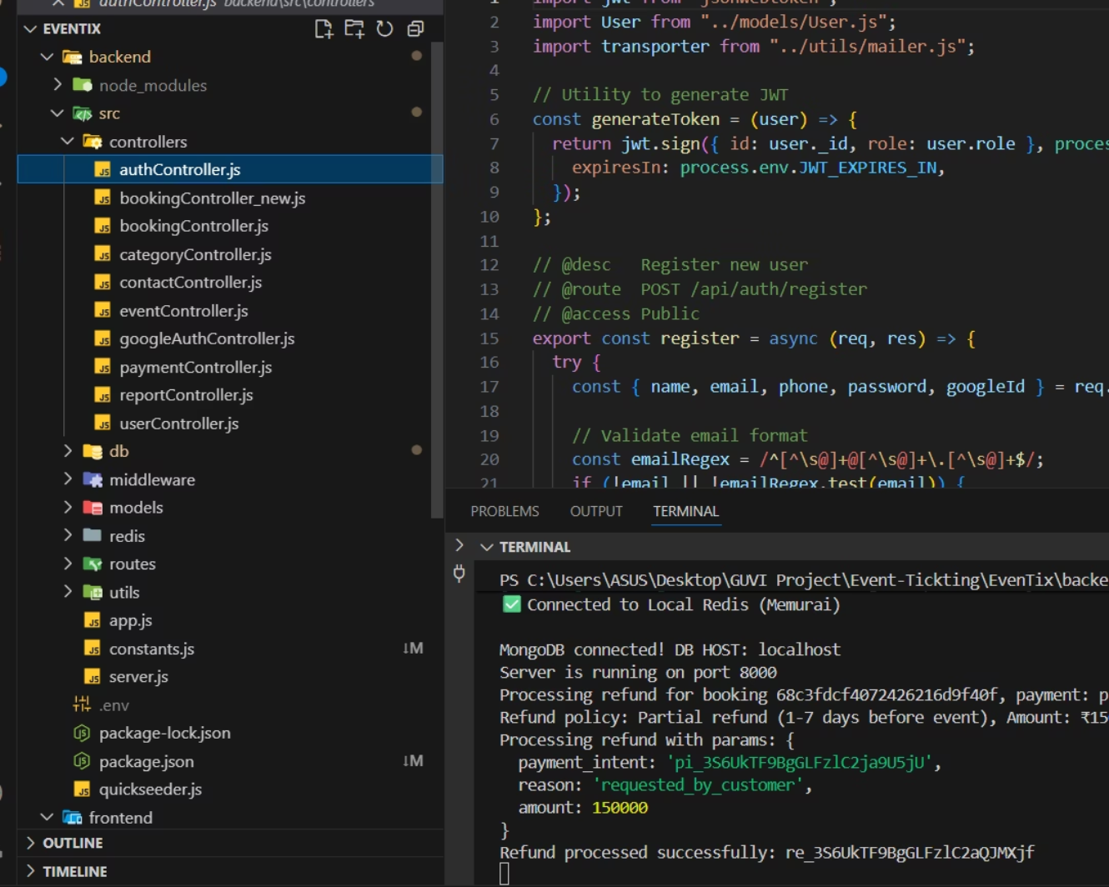
Frontend – Backend – Database Workflow
Example Flow – Ticket Booking:
User selects event
Backend validates data and stores booking in MongoDB
Display confirmation to user
1
2
3
4
5
API call to backend endpoint POST /api/bookings
Response sent back to frontend

Slide 7










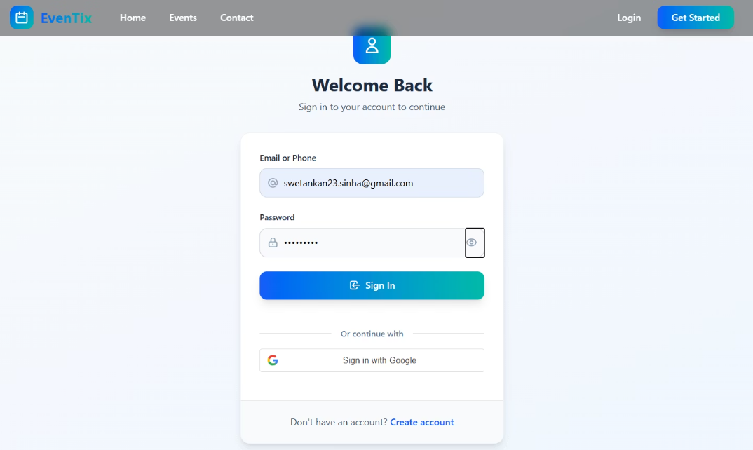
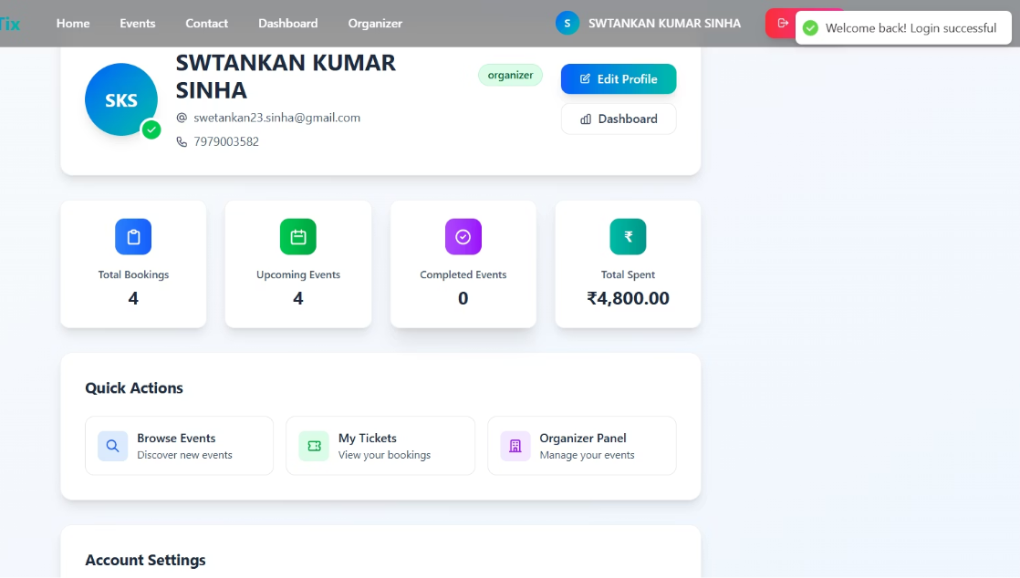

Security Implementation
Secure login using JWT and Google OAuth
Passwords stored hashed
Rate limiting implemented using Redis
Validation for all API requests
Custom middleware to handle authentication & banned users
Login Page
Organizers Dashboard

Slide 8

Performance Optimisation
MongoDB Indexes applied on event date and user ID fields
Redis used for caching popular event listings
Paginated API responses to handle large datasets efficiently
Railway Backend Deployment

Slide 9




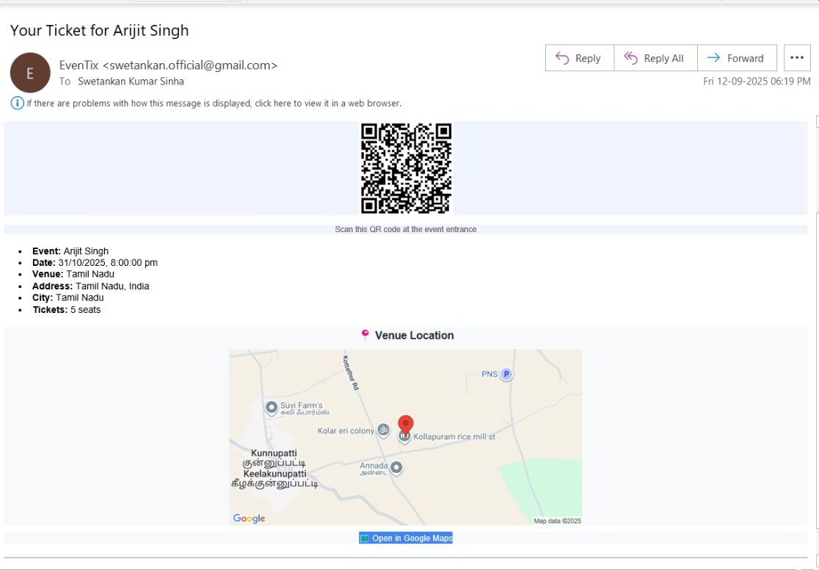
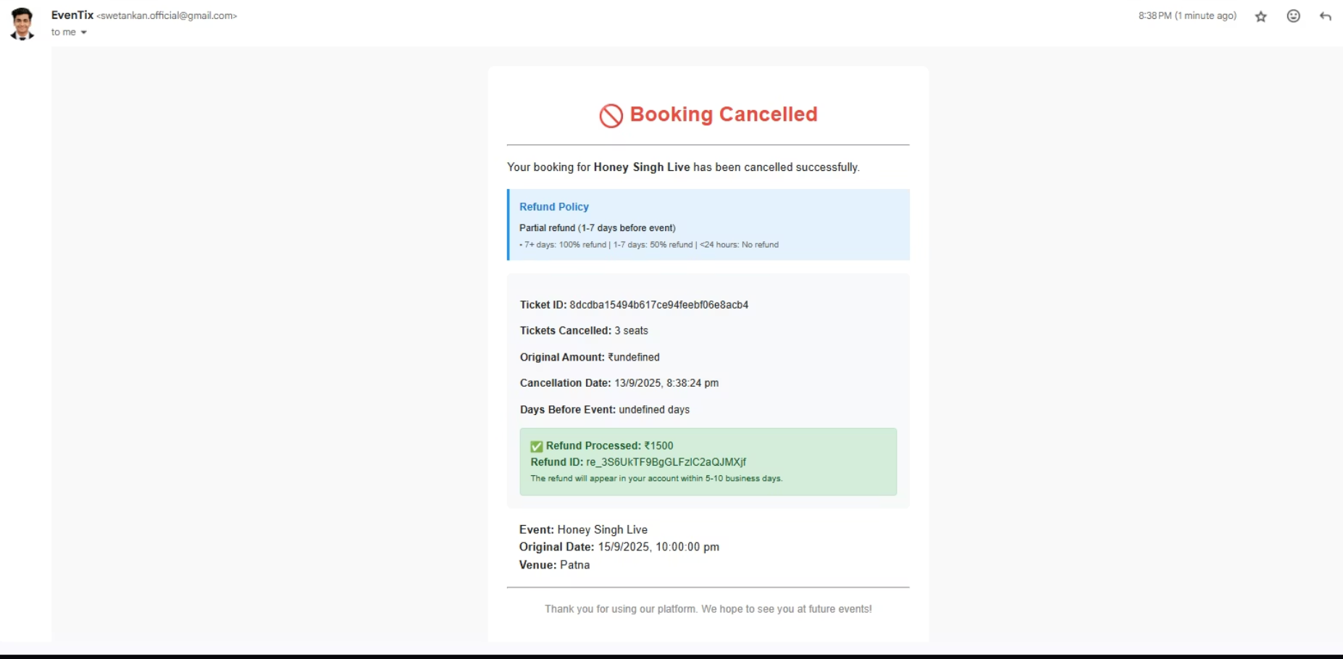
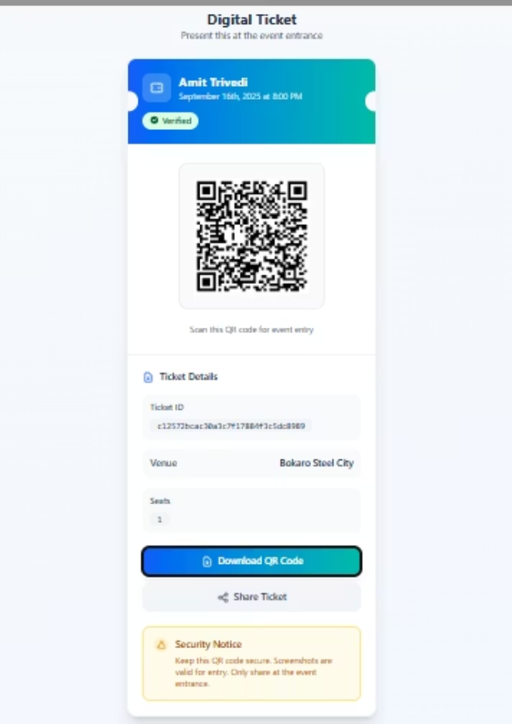
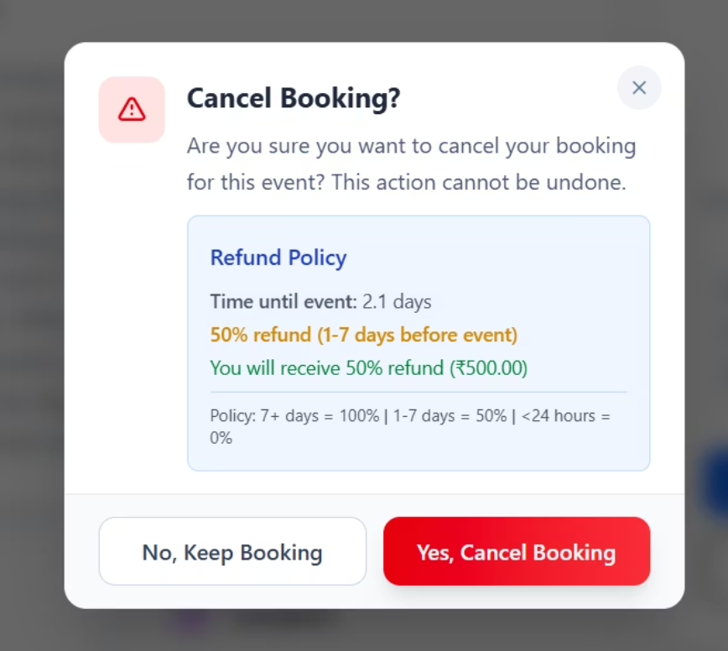
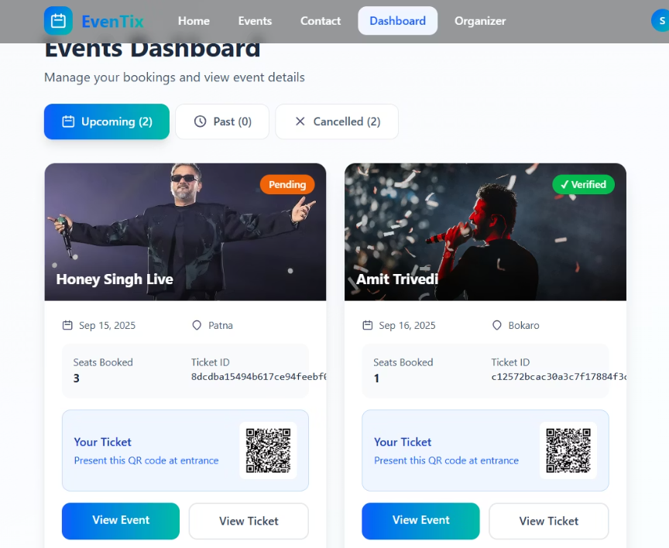
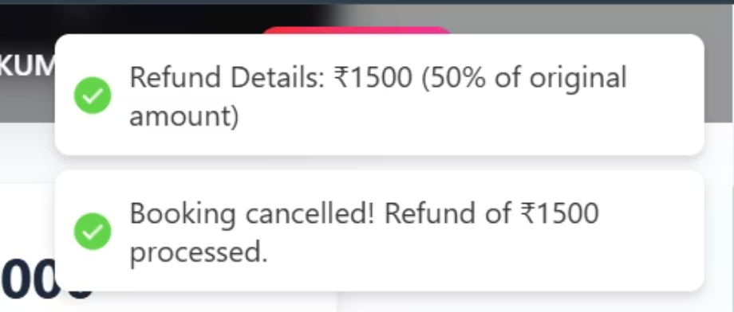

Innovative Features
QR Code generation for ticket verification
Google Maps integrated for venue display
Real-time analytics dashboard for event organisers
Automated refund handling on event cancellation
Email copy of Booking Cancelled
Email of Booked ticket with QR and Map
Refund Issued
Ticket with QR
Cancel Ticket

Slide 10
Documentation & Deployment
Well-documented API endpoints in README
• Live demo deployed: ​https://even-tix.vercel.app•​ Source code hosted: ​Eventix
​• Environment variables securely managed via .env files

